Slide 1
HUMAN-AI INTERACTION COURSE | PROJECT MILESTONE
Academic Writing Coach
An Interactive AI Assistant for University Students Focusing on Transparency, Grounded Feedback, and Uncertainty Handling.

Slide 2
1. Project Overview & Context
The Student Challenge
Our Solution & Transparency
University students frequently struggle with academic phrasing, formal tone, structural coherence, and proper citation formats (APA, MLA, IEEE) when drafting term papers and research reports.
Generic AI tools often provide ungrounded rewrites or plausible-sounding fabrications (AI hallucinations), undermining academic integrity.
The Academic Writing Coach acts as an interactive pedagogical consultant. Students submit draft excerpts and receive constructive feedback.
Every critique is anchored to official style guides. When rules are ambiguous, the system explicitly discloses uncertainty.

Slide 3
2. Fictional User Personas
Persona 1
Persona 2
Persona 3
Youssef Ibrahim
Mariam Adel
Ziad Khaled
Below-Typical Tech Level & Accessibility Needs
Typical Technical Level
Advanced Technical Level
First-year student unfamiliar with AI tools. Needs high contrast, plain-language explanations, and clear citation badges without dense stylistic jargon.
Second-year student who understands basic essay structure but struggles with proper in-text citation formatting and formal academic tone.
Third-year student experienced in research synthesis. Seeks direct style manual citations and advanced structural diagnostics instantly.
Focus: Accessibility & Simplicity
Focus: Rule Verification & Tone
Focus: Granular Diagnostics

Slide 4
3. Bias Check & Data Source Design
Bias-Check Highlights
Synthetic Data Source
Cultural Neutrality: technical proficiency and writing capability are decoupled from cultural backgrounds.
Accessibility-First: UI design avoids color-only indicators, supporting cognitive load sensitivity.
Uncertainty Handling: prevents the system from enforcing subjective stylistic norms as absolute rules.
Curated JSON dataset (academic_guidelines_dataset.json) targeting 40 structured cases: grammar, citation rules, structural arguments, and insufficient-context cases.
Contains zero real student personal data or private drafts, ensuring complete privacy compliance.

Slide 5
Milestone 1: Two AI Concept Drafts Side-by-Side
Draft A (ChatGPT): Conversational Mentoring Flow
Draft B (Gemini): Rule-Based Citation & Style Board
A question-first, guided-diagnosis approach where students submit text and receive incremental hints and conversational explanations before seeing fixes.
Strength: Intuitive & flexible.
Weakness: Open-ended queries can overwhelm beginners.
A structured verification board where students select style manual criteria (APA/IEEE) to systematically validate references and structural guidelines.
Strength: Highly rigorous.
Weakness: Can feel rigid for creative drafting.

Slide 6
Milestone 1: Direction & Unique Scope Approval
Chosen Direction & Rationale
Unique Idea & Scope Approval
We chose a hybrid architecture combining Conversational Mentoring (Draft A) with Rule-Based Citation Verification (Draft B). This grants students full control over their editing path while enforcing strict style manual grounding and transparency.
Target User Group: University students seeking academic writing support.
Unique Value: unlike general helpdesks or coding mentors, our project targets academic prose, stylistic critique, and style-guide grounding with explicit uncertainty handling.

Slide 7
4. End-to-End System Workflow
1
Input & Start
Student submits draft paragraph and writing query via the responsive web interface.
2
Grounding & Backend Verification
Python FastAPI backend checks the query against academic_guidelines_dataset.json.
3
Transparent Feedback Delivery
System returns constructive critique paired with official style guide badges or uncertainty notes.
4
Action & Feedback
Student applies independent revisions and submits ratings to refine system performance.

Slide 8
5. User Journey Stages
1. Start
2. Ask
3. Understand
4. Act / Fix
5. Finish
Anxiety over looming essay deadlines and citation rules.
Submitting draft excerpts with plain-language queries.
Reviewing critique paired with style manual references.
Following official style links to revise drafts independently.
Submitting revised essays with confidence and accuracy.

Slide 9
6. Measurable Objectives (Target Metrics)
O1: Rule & Citation Accuracy
≥ 90% accuracy
O2: Task Success Rate
≥ 80% success
O3: Transparency Comprehension
≥ 90% comprehension
O4: Performance Latency
< 2.0 seconds
O5: Uncertainty Handling Rate
≥ 95% fallback rate

Slide 10
7. HAI Principle Ladder: Transparency
Level 1: Inform
Discloses AI assistant scope and capabilities upon opening the chat interface.
Level 2: Explain (Rule Attribution)
Attaches direct style manual links and references to every structural critique.
Level 3: Allow Control (Uncertainty Disclosure)
Displays explicit uncertainty warnings when stylistic rules are ambiguous or open to instructor discretion.
Level 4: Enable Feedback
Collects user ratings on suggestion clarity and helpfulness to continuously refine the mentor.

Slide 11
8. Technical Architecture & Evaluation
Technical Architecture
Evaluation Plan
Frontend: HTML5, CSS3, JavaScript with accessible card layouts and screen-reader support.
Backend: Python FastAPI handling request routing and rule validation.
Grounding: hosted LLM API integrated with academic_guidelines_dataset.json.
Technical testing: automated script verification of feedback against official style manuals.
Usability testing: peer testing with at least 5 student participants performing essay revisions.
SUS surveys: System Usability Scale questionnaires.

Slide 12
WEEK 5
Flow and Architecture
Conversation flow, system architecture, Shneiderman's 8 Golden Rules, and our first backend model call.

Slide 13
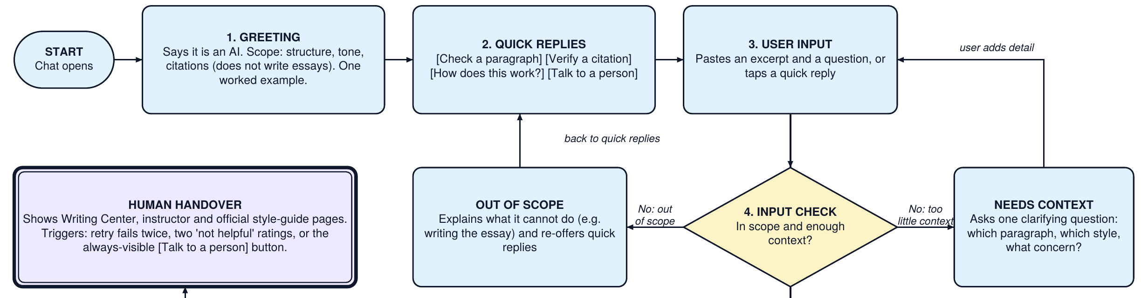
9. Conversation Flow: Main Path
Greeting: states it is an AI, its scope (structure, tone, citations), and shows a worked example.
Quick replies: Check a paragraph, Verify a citation, How does this work?, Talk to a person.
Input check: out-of-scope requests are politely redirected; unclear input gets one clarifying question.
Notes:
Greeting states AI identity and scope, then quick replies. The input check blocks out-of-scope requests and asks for context before any model call.

Slide 14
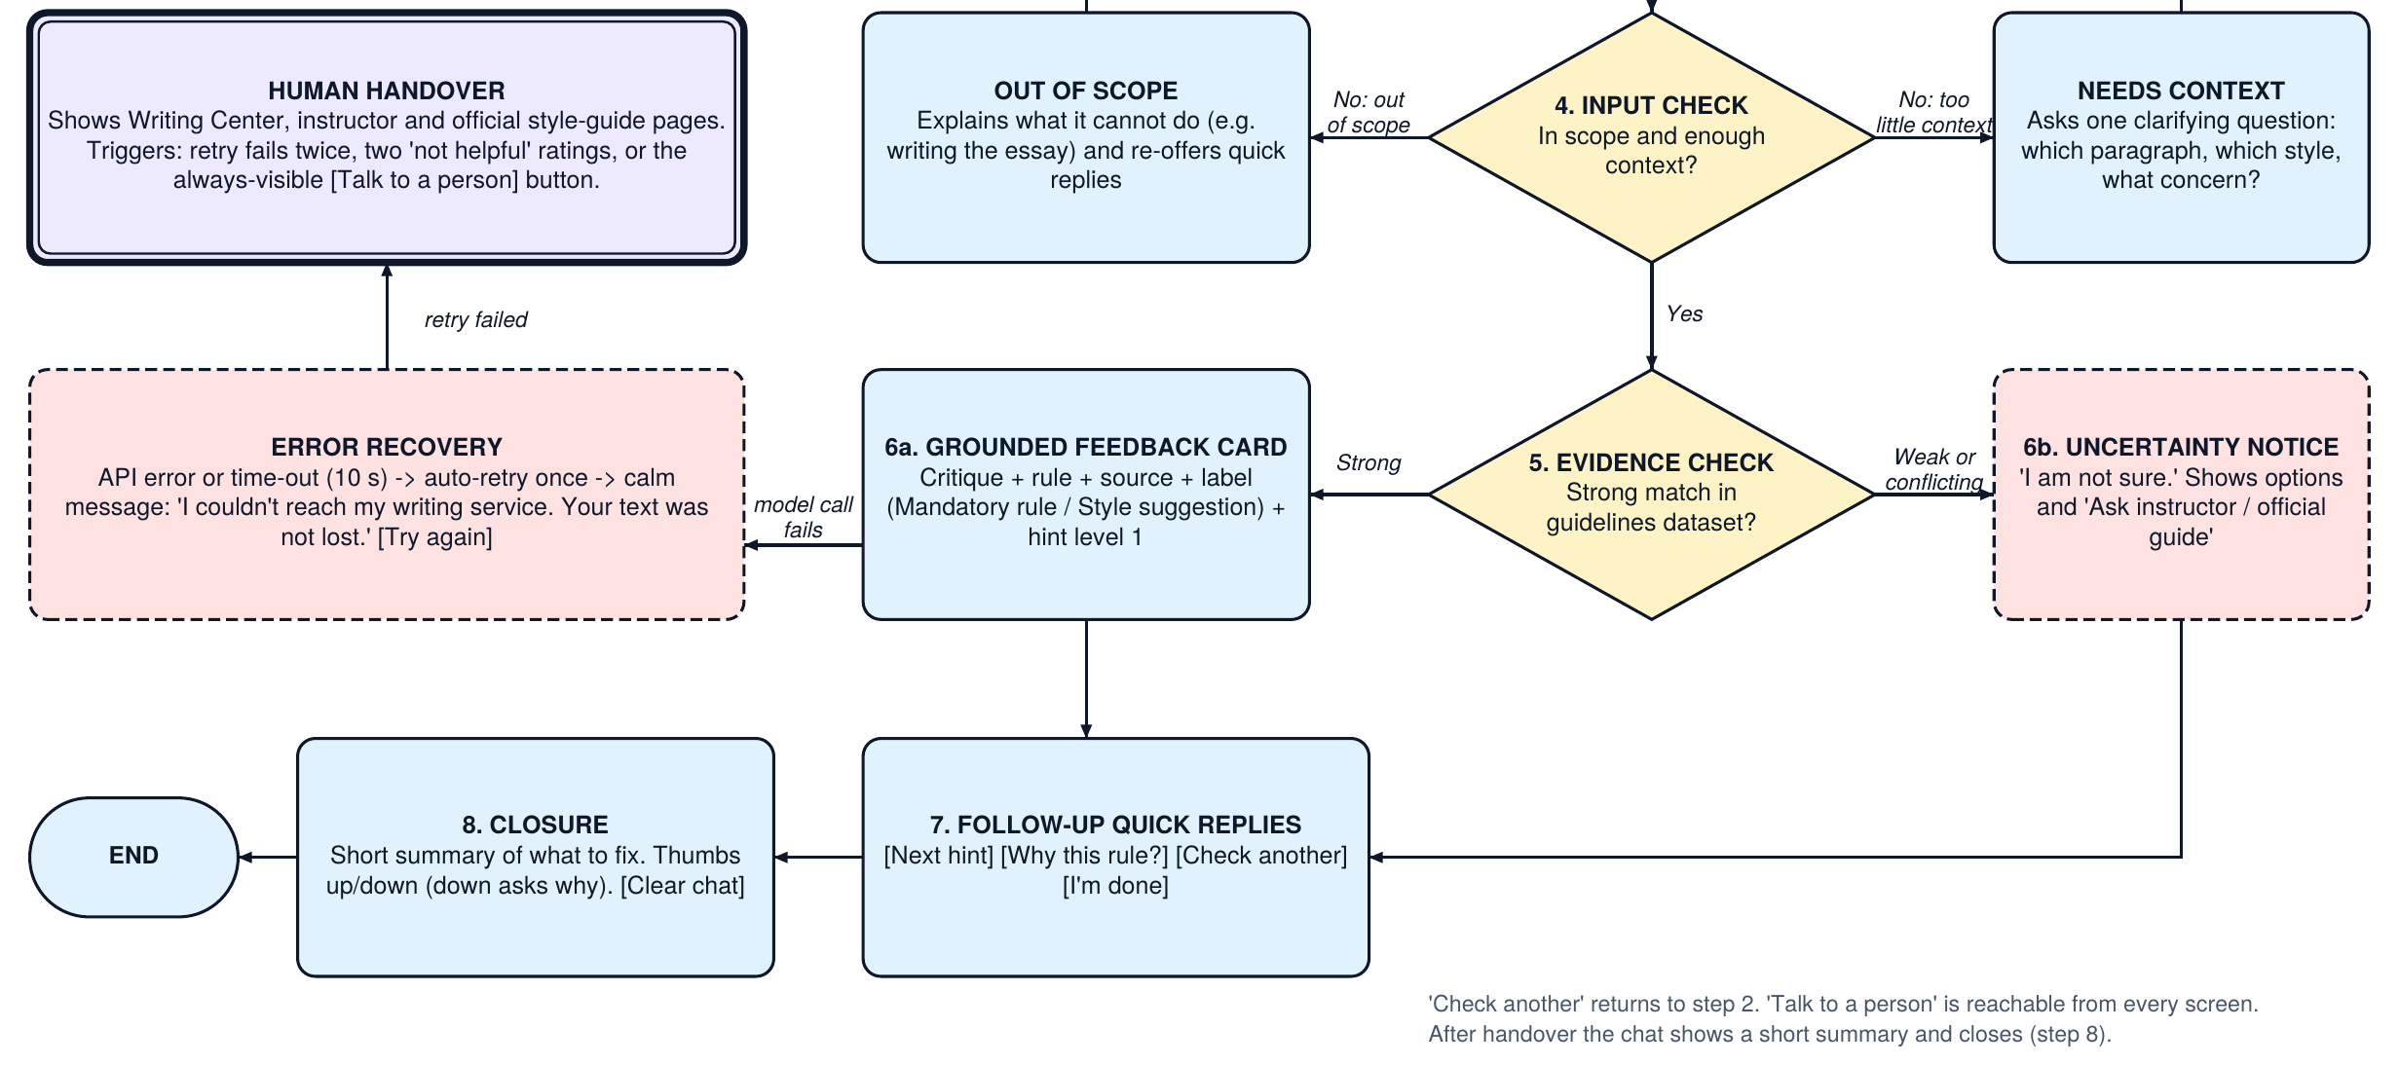
9. Conversation Flow: Answers, Errors & Handover
Handover triggers: retry fails twice, two 'not helpful' ratings in a row, or the always-visible [Talk to a person] button. Dashed border = error or uncertainty path; double border = human handover.
Notes:
Strong evidence gives a grounded card. Weak evidence gives an uncertainty notice. API errors retry once, show a calm fallback, then offer a human.

Slide 15
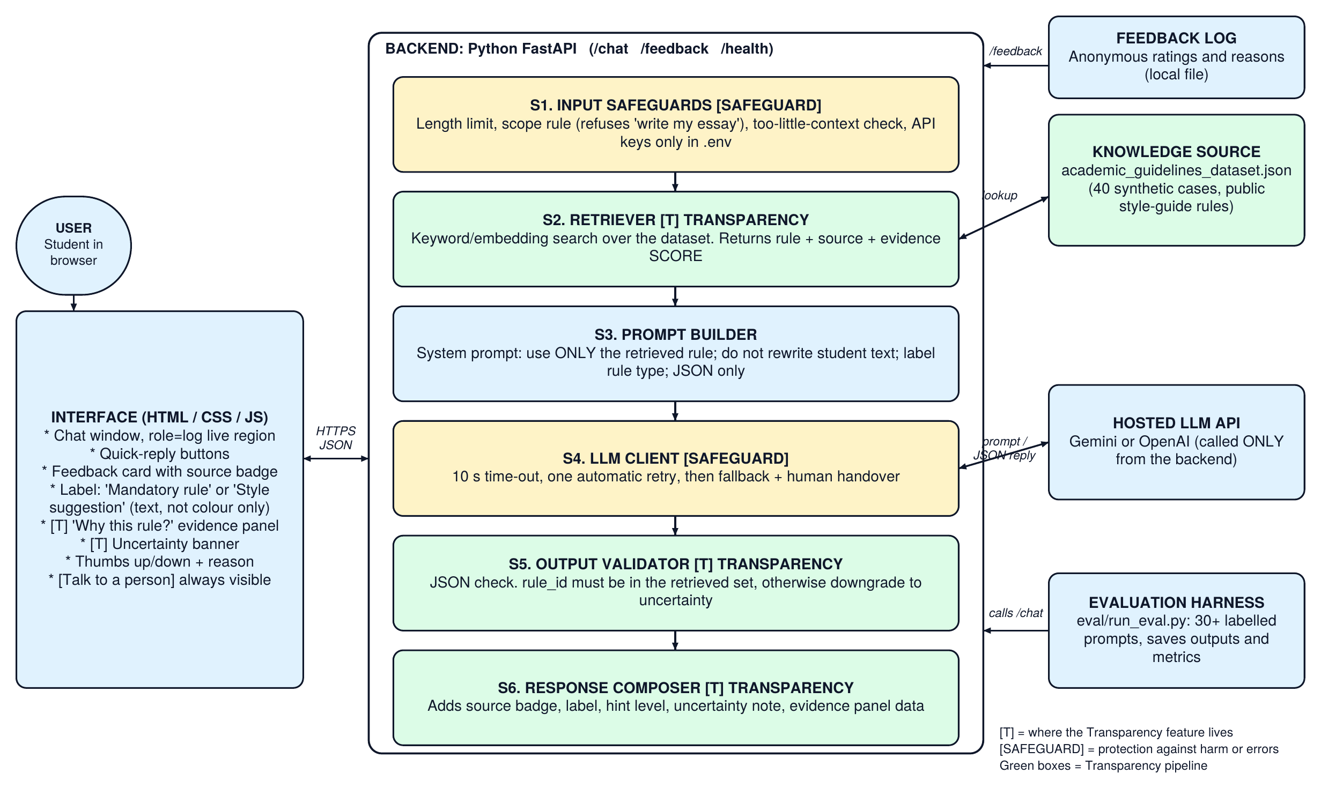
10. System Architecture
Notes:
The principle feature lives in the pipeline: retriever (evidence score), output validator (rule must match evidence), and response composer (real evidence sent to the interface).

Slide 16
10. Where the Transparency Feature Lives
S2 Retriever
S5 Output Validator
S6 Response Composer
Searches the guidelines dataset and returns the rule, its source, and an evidence score.
A low score means the system says "I am not sure" instead of guessing.
The model's rule_id must be in the retrieved set.
If not, the answer is hidden and replaced with an uncertainty notice.
Sends the real evidence to the interface.
The "Why this rule?" panel shows what the system actually used, never an explanation written afterwards.
Safeguards: input length and scope checks, 10 s time-out with one retry, JSON validation, API keys only in a git-ignored .env file, synthetic data only.

Slide 17
11. Shneiderman's 8 Golden Rules (1/2)
1. Strive for consistency
Same feedback card layout every time; labels always 'Mandatory rule' or 'Style suggestion'; same quick-reply wording.
2. Enable shortcuts
Quick-reply buttons; 'Show source only' for advanced users; Enter to send, Tab through all buttons.
3. Offer informative feedback
'Checking the style guide...' status; every answer shows source and label; clear uncertainty and error messages.
4. Design dialogs that give closure
Closure step: short summary of what to fix, rating prompt, and a clear next contact after handover.

Slide 18
11. Shneiderman's 8 Golden Rules (2/2)
5. Prevent errors, handle them simply
Input check before the model call; validator blocks invented rules; one plain sentence plus [Try again].
6. Permit easy reversal
[Clear chat], edit and resend, 'Previous hint'. The system never changes the student's text.
7. Support sense of control
Student picks style manual and hint level; AI explains but never rewrites; [Talk to a person] always visible.
8. Reduce short-term memory load
Rule and source stay attached to each card; quick replies show next actions; one hint at a time; Help button.

Slide 19
12. First Model Response from Our Backend
# backend/app/llm.py (core)
key = os.getenv("GEMINI_API_KEY")
r = httpx.post(url, json=body,
headers={"x-goog-api-key": key},
timeout=10)
r.raise_for_status()
# one call + ONE automatic retry
for attempt in (1, 2):
try: return PROVIDERS[provider](...)
except (HTTPError, LLMError): ...
raise LLMError # -> fallback + handover
What the response contains
status, message, hint, label (mandatory rule or style suggestion)
evidence: rule_id, rule, source, score
latency_ms and an optional uncertainty note
Captured from our backend (offline test, mock model)
status: ok label: mandatory_rule
rule_id: CF-001 score: 0.59
source: APA Publication Manual, 7th ed., Ch. 8
latency_ms: 3
No API key -> status: error + calm fallback
Notes:
Run uvicorn, then scripts/first_call.py. The call is made by our FastAPI backend; the key is read from an environment variable.

Slide 20
13. Next Steps (Week 6 onward)
Onboarding & test set
Three-stage onboarding, Feature Choice Board, 15+ labelled test prompts.
Accessible interface
Chat UI with live region, keyboard use, contrast, 200% zoom.
Evaluation harness
30+ prompt test set, saved outputs, baseline metrics for O1 to O5.

Slide 21
Thank You!
Questions & Discussion

